Slide 1

BikeDeed
Blockchain Protected!

Slide 2
The Problem
There is currently no Universal, Trusted, Borderless, Decentralized repository for the registration, transfer and tracking of ownership for bicycles.
So, why should I care?

Slide 3
The Numbers
Two Billion
Number of bicycles in use around the world.
One Hundred Million
The number of new bicycles manufactured worldwide each year.
One and a Half Million
Number of bicycles stolen each year in the U.S.
Zero
The number of bicycles currently registered on the Blockchain.

Slide 4
The Pitch
Getting the average person to see beyond the hype of tokens, Blockchain and ICOs is a difficult task. People need to be exposed to real-world applications that are based on concepts they already understand before they will be open to the ideas that make Decentralization so exciting and revolutionary. That was the primary motivation for creating BikeDeed.
The gigantic market of bicycle ownership represents a unique opportunity to bring a significant portion of the world’s population into the Blockchain ecosystem, leading to further opportunities of exposing them to a myriad of other products.

Slide 5
The Opportunity
A Universal, Trusted, Borderless, Decentralized, repository for the registration, transfer and tracking of ownership for bicycles.
Each bicycle is labeled with a QR Code and registered on the Blockchain before it leaves the factory. When the bike is shipped to a wholesaler, the bike deed is transferred to that party. When the bike is shipped to the local bike shop for retail sale, the deed is transferred to the local bike shop. When the bike is sold to an individual, the deed is transferred to the individual owner.
During every stage of a bicycle’s life, the owner can use the mobile app to easily prove that he/she is the owner by scanning the QR code on the bike.

Slide 6
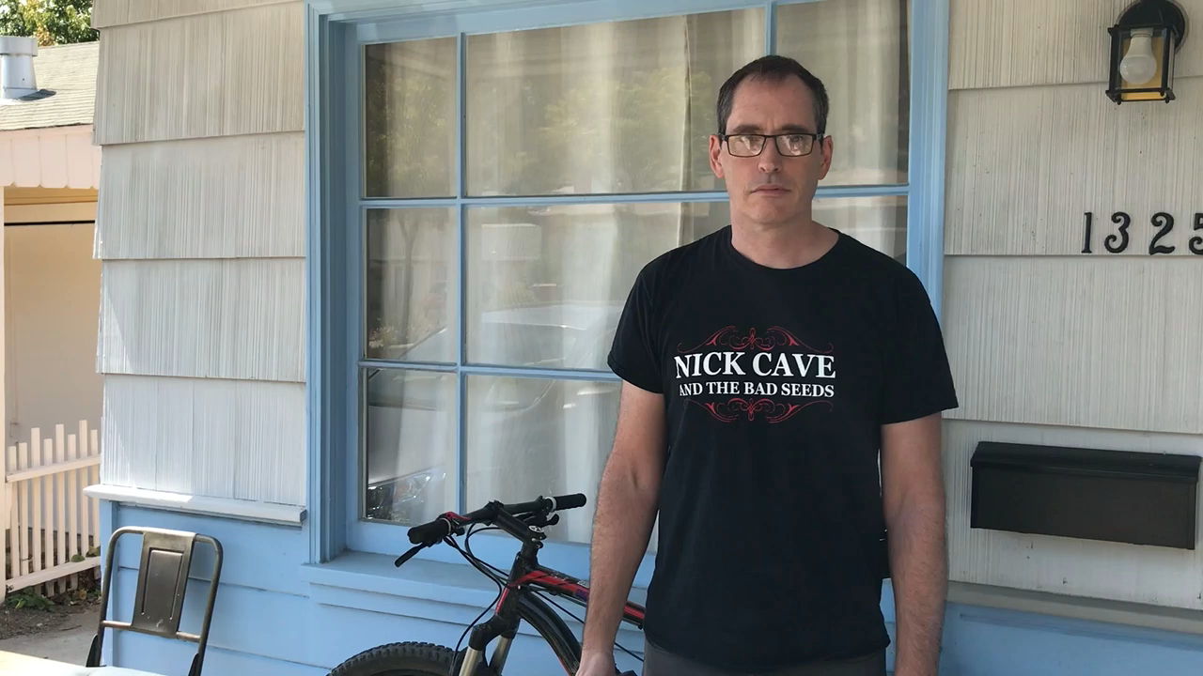
The 30 Second Demo

Slide 7
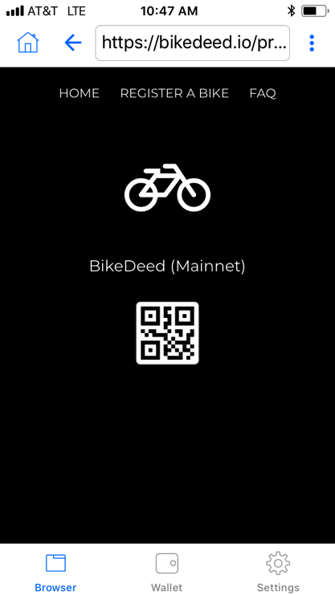
Features
Proof of Ownership.
List/Search Bikes and Owners.
Track Bike Supply Chain.
Track Bike Maintenance.
Theft/Recovery and Law Enforcement.
QR Codes.
Mobile and Desktop.

Slide 8
The Geek Stuff
BikeDeed is a Decentralized proof-of-ownership application running as a smart contract on the Ethereum Blockchain. Technologies include:
ERC721 non-fungible tokens
IPFS
Web3
The Minimum Viable Product is up and running on the Ethereum mainnet right now. Go to https://bikedeed.io

